Slide 1
INTRODUCTION TO COMPUTING
Course Code: CCINCOM/L
Linked List
Department of Computer Science
College of Computing and Information Technologies (CCIT)
National University
Joseph Marvin R. Imperial
DATA STRUCTURES AND ALGORITHMS
NU College of Computing and Information Technologies
Course Code: CCDATRCL

Slide 2
Recap: Arrays
The array is the most commonly used data storage structure; it’s built into most programming languages.
Why not use arrays for everything?
Joseph Marvin R. Imperial
DATA STRUCTURES AND ALGORITHMS
NU College of Computing and Information Technologies
Course Code: CCDATRCL

Slide 3
Why not use arrays for everything?
In an unordered array you can insert items quickly, in constant time, but searching takes longer time, proportional to size.
In an ordered array you can search quickly, in constant time, but insertion longer time, proportional to size.
For both kinds of arrays, deletion takes longer time proportional to size because half the items (on the average) must be moved to fill in the hole.
The initial size is fixed for static arrays, the initial size is doubled for dynamic arrays with overhead.
We need a data structure which is more flexible and can expand to hold the number of items inserted in it. Enter linked list.
Joseph Marvin R. Imperial
DATA STRUCTURES AND ALGORITHMS
NU College of Computing and Information Technologies
Course Code: CCDATRCL

Slide 4


A linked list is just a list
Joseph Marvin R. Imperial
DATA STRUCTURES AND ALGORITHMS
NU College of Computing and Information Technologies
Course Code: CCDATRCL
Notes:
Starts from the first to the last item

Slide 5
Linked List
The linked list is a versatile data structure which contains a collection of objects linked together by references from one object to another object.
It can be used as the basis for other data storage structures such as stacks and queues.
The second most commonly used general purpose storage structures after arrays.
In fact, you can use a linked list in many cases in which you use an array, unless you need frequent random access to individual items using an index.
Joseph Marvin R. Imperial
DATA STRUCTURES AND ALGORITHMS
NU College of Computing and Information Technologies
Course Code: CCDATRCL
Notes:
Linked lists aren’t the solution to all data storage problems, but they are surprisingly versatile and conceptually simpler than some other popular structures such as trees. We’ll investigate their strengths and weaknesses as we go along.

Slide 6
Link / Node
In a linked list, each data item is embedded in a link or node. A link is an object of a class specifically for items in the list.
Separate class for links / nodes, another separate class for the linked list itself.
Each Link object contains a reference (usually called next) to the next link in the list.
Joseph Marvin R. Imperial
DATA STRUCTURES AND ALGORITHMS
NU College of Computing and Information Technologies
Course Code: CCDATRCL

Slide 7
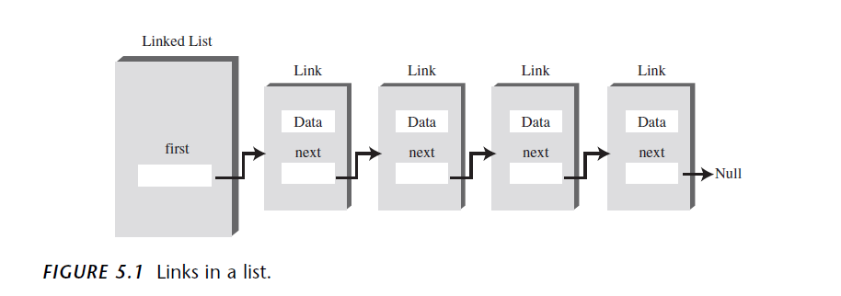
A linked list with nodes
Joseph Marvin R. Imperial
DATA STRUCTURES AND ALGORITHMS
NU College of Computing and Information Technologies
Course Code: CCDATRCL

Slide 8
A linked list with nodes
Joseph Marvin R. Imperial
DATA STRUCTURES AND ALGORITHMS
NU College of Computing and Information Technologies
Course Code: CCDATRCL

Slide 9
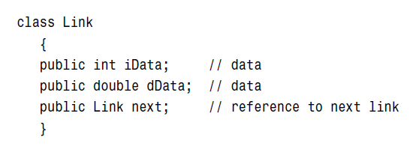
A Link / Node
This kind of class definition is sometimes called self-referential because it contains a field—called next in this case—of the same type as itself.
Joseph Marvin R. Imperial
DATA STRUCTURES AND ALGORITHMS
NU College of Computing and Information Technologies
Course Code: CCDATRCL

Slide 10
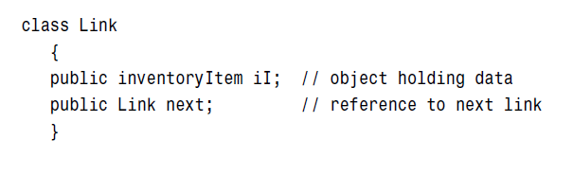
A Link / Node
In a typical application there would be many more. A personnel record, for example, might have name, address, Social Security number, title, salary, and many other fields. Take note, real world data.
Joseph Marvin R. Imperial
DATA STRUCTURES AND ALGORITHMS
NU College of Computing and Information Technologies
Course Code: CCDATRCL

Slide 11
Referencing to other Links inside a Link
A Link object doesn’t really contain another Link object, although it may look like it does. The next field of type Link is only a reference to another link, not an object.
A reference is a number that refers to an object. It’s the object’s address in the computer’s memory, but you don’t need to know its value; you just treat it as a magic number that tells you where the object is.
Joseph Marvin R. Imperial
DATA STRUCTURES AND ALGORITHMS
NU College of Computing and Information Technologies
Course Code: CCDATRCL

Slide 12
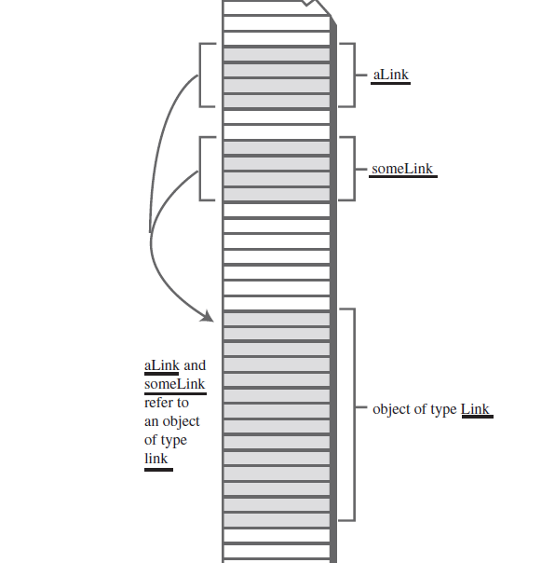


Joseph Marvin R. Imperial
DATA STRUCTURES AND ALGORITHMS
NU College of Computing and Information Technologies
Course Code: CCDATRCL

Slide 13
Relationship, Not Position
In an array each item occupies a particular position. This position can be directly accessed using an index number.
In a linked list the only way to find a particular element is to follow along the chain of elements. It’s more like human relations.
Scenario:
Maybe you ask Harry where Bob is. Harry doesn’t know, but he thinks Jane might know, so you go and ask Jane. Jane saw Bob leave the office with Sally, so you call Sally’s cell phone, etc.
Joseph Marvin R. Imperial
DATA STRUCTURES AND ALGORITHMS
NU College of Computing and Information Technologies
Course Code: CCDATRCL
Notes:
In an array each item occupies a particular position. This position can be directly accessed
using an index number. It’s like a row of houses: You can find a particular house
using its address.

Slide 14
Characteristics of Linked List
Linked lists as a data structure have the following characteristics:
Insertion is O(1) for the insert action
Deletion is O(n)
Searching is O(n)
Traversing is O(n)
O(n) – means proportional to size of the list or n
O(1) – constant time
Joseph Marvin R. Imperial
DATA STRUCTURES AND ALGORITHMS
NU College of Computing and Information Technologies
Course Code: CCDATRCL

Slide 15
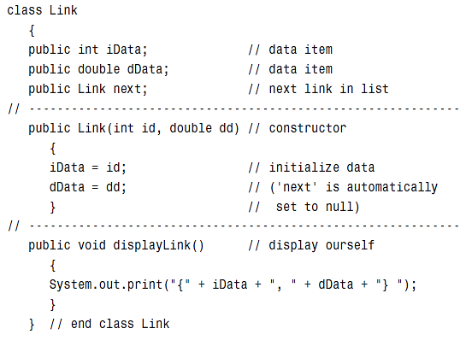
The Link / Node class
Joseph Marvin R. Imperial
DATA STRUCTURES AND ALGORITHMS
NU College of Computing and Information Technologies
Course Code: CCDATRCL

Slide 16
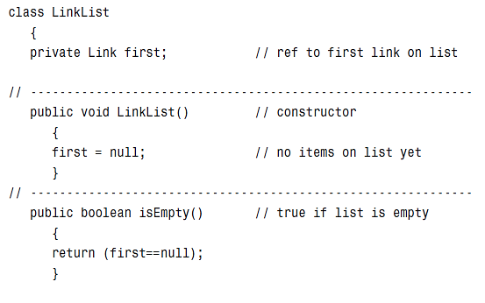

The LinkedList class
Joseph Marvin R. Imperial
DATA STRUCTURES AND ALGORITHMS
NU College of Computing and Information Technologies
Course Code: CCDATRCL

Slide 17
Traversing
You start at the head of the list and continue until you come across a node that is null. A simple while loop can be used.
The two cases are as follows:
node = null;, we have exhausted all nodes in the linked list
we must update the node reference to be node.Next
Joseph Marvin R. Imperial
DATA STRUCTURES AND ALGORITHMS
NU College of Computing and Information Technologies
Course Code: CCDATRCL

Slide 18
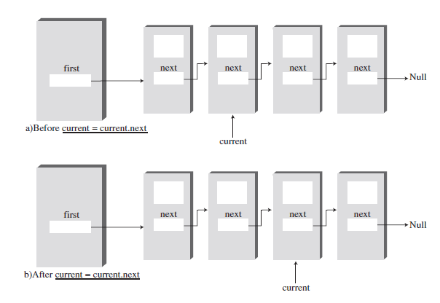
Display the whole list by traversing
Joseph Marvin R. Imperial
DATA STRUCTURES AND ALGORITHMS
NU College of Computing and Information Technologies
Course Code: CCDATRCL

Slide 19
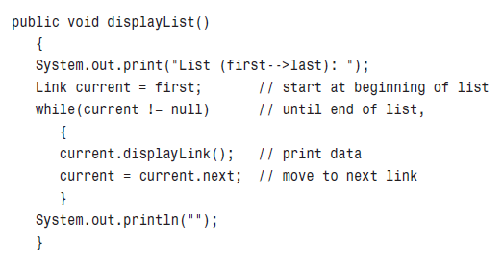
Display the whole list by traversing
Joseph Marvin R. Imperial
DATA STRUCTURES AND ALGORITHMS
NU College of Computing and Information Technologies
Course Code: CCDATRCL

Slide 20
Insertion
In general, when people talk about insertion with respect to linked lists of any form they implicitly refer to the adding of a node to the tail of the list.
Adding a node to a singly linked list has only two cases:
head = null; in which case the node we are adding is now both the head and tail of the list
we simply need to append our node onto the end of the list updating the tail reference appropriately
Joseph Marvin R. Imperial
DATA STRUCTURES AND ALGORITHMS
NU College of Computing and Information Technologies
Course Code: CCDATRCL

Slide 21
Insertion
1 | Insertion at beginning | It involves inserting any element at the front of the list. We just need to a few link adjustments to make the new node as the head of the list.
2 | Insertion at end of the list | It involves insertion at the last of the linked list. The new node can be inserted as the only node in the list or it can be inserted as the last one.
3 | Insertion after specified node | It involves insertion after the specified node of the linked list. We need to skip the desired number of nodes in order to reach the node after which the new node will be inserted.
Joseph Marvin R. Imperial
DATA STRUCTURES AND ALGORITHMS
NU College of Computing and Information Technologies
Course Code: CCDATRCL

Slide 22
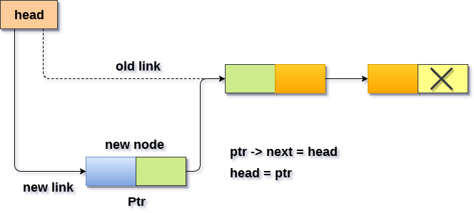
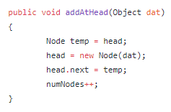
Insert at the beginning
Joseph Marvin R. Imperial
DATA STRUCTURES AND ALGORITHMS
NU College of Computing and Information Technologies
Course Code: CCDATRCL

Slide 23
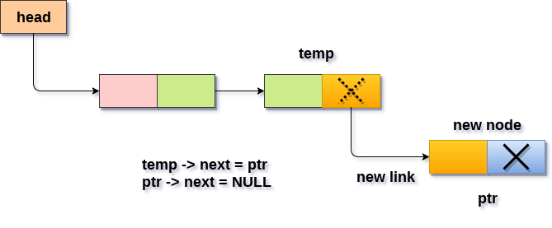
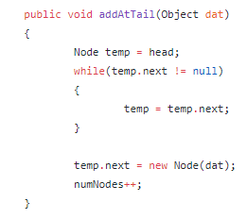
Insert at the end of the list
Joseph Marvin R. Imperial
DATA STRUCTURES AND ALGORITHMS
NU College of Computing and Information Technologies
Course Code: CCDATRCL

Slide 24
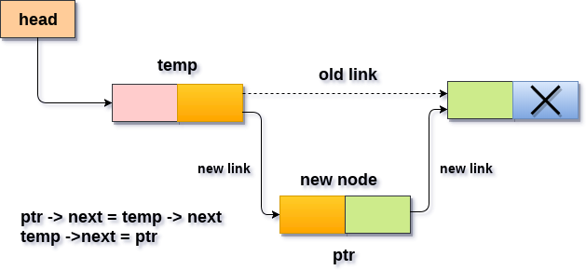
Insert after a specific index
Joseph Marvin R. Imperial
DATA STRUCTURES AND ALGORITHMS
NU College of Computing and Information Technologies
Course Code: CCDATRCL

Slide 25
Deletion
Deleting a node from a linked list is straightforward but there are a few cases we need to account for:
the list is empty
the node to remove is the only node in the linked list
we are removing the head node
we are removing the tail node
the node to remove is somewhere in between the head and tail
the item to remove doesn't exist in the linked list
Joseph Marvin R. Imperial
DATA STRUCTURES AND ALGORITHMS
NU College of Computing and Information Technologies
Course Code: CCDATRCL

Slide 26
Deletion
1 | Deletion at beginning | It involves deletion of a node from the beginning of the list. This is the simplest operation among all. It just need a few adjustments in the node references.
2 | Deletion at the end of the list | It involves deleting the last node of the list. The list can either be empty or full.
3 | Deletion of specified node | It involves deleting the node on the specified index of the list. We need to skip the desired number of nodes to reach the node after which the node will be deleted. This requires traversing through the list.
Joseph Marvin R. Imperial
DATA STRUCTURES AND ALGORITHMS
NU College of Computing and Information Technologies
Course Code: CCDATRCL

Slide 27
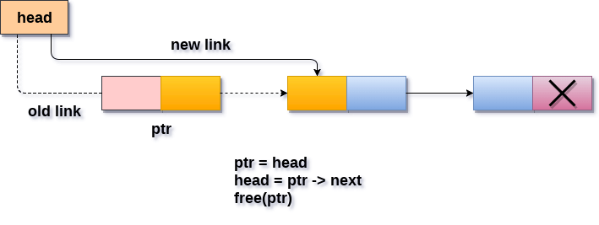
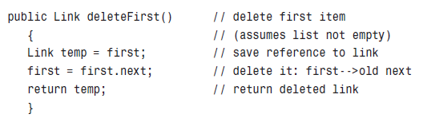
Delete first element
Joseph Marvin R. Imperial
DATA STRUCTURES AND ALGORITHMS
NU College of Computing and Information Technologies
Course Code: CCDATRCL

Slide 28
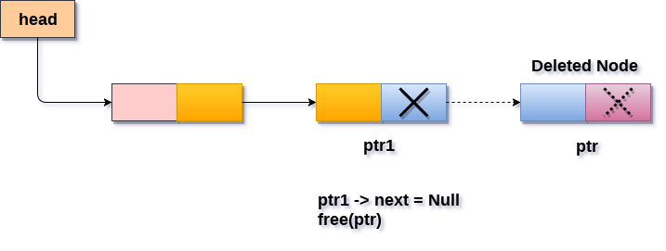
Delete last element
Joseph Marvin R. Imperial
DATA STRUCTURES AND ALGORITHMS
NU College of Computing and Information Technologies
Course Code: CCDATRCL

Slide 29
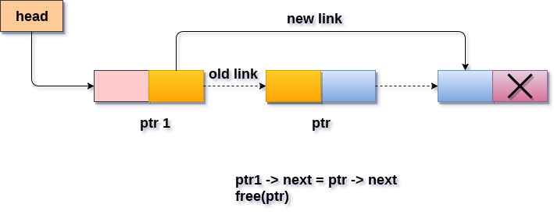
Delete after a specific node
Joseph Marvin R. Imperial
DATA STRUCTURES AND ALGORITHMS
NU College of Computing and Information Technologies
Course Code: CCDATRCL

Slide 30
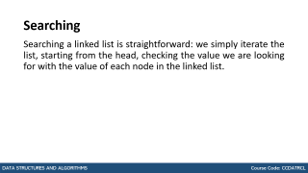
Searching
Searching a linked list is straightforward: we simply iterate the list, starting from the head, checking the value we are looking for with the value of each node in the linked list.
Joseph Marvin R. Imperial
DATA STRUCTURES AND ALGORITHMS
NU College of Computing and Information Technologies
Course Code: CCDATRCL

Slide 31
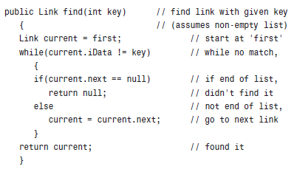
Searching
Joseph Marvin R. Imperial
DATA STRUCTURES AND ALGORITHMS
NU College of Computing and Information Technologies
Course Code: CCDATRCL

Slide 32
Summary
A linked list consists of one linkedList object and a number of Link objects.
Each Link object contains data and a reference, often called next, to the next link in the list.
Linked lists are good to use when you have an unknown number of items to store.
Linked lists are not very good for is random insertion, accessing nodes by index, and searching.
Joseph Marvin R. Imperial
DATA STRUCTURES AND ALGORITHMS
NU College of Computing and Information Technologies
Course Code: CCDATRCL

Slide 33
Summary
We must begin from the head of the list and traverse the list sequentially to access the nodes in the list.
Joseph Marvin R. Imperial
DATA STRUCTURES AND ALGORITHMS
NU College of Computing and Information Technologies
Course Code: CCDATRCL

